Slide 1
The Chevron package
A open-source package to facilitate generation of outputs
Liming Li, technical lead for chevron
DATE | confidentiality level

Slide 2
Table of contents
Introduction
Challenges
The {chevron} package

Slide 3
Introduction

Slide 4

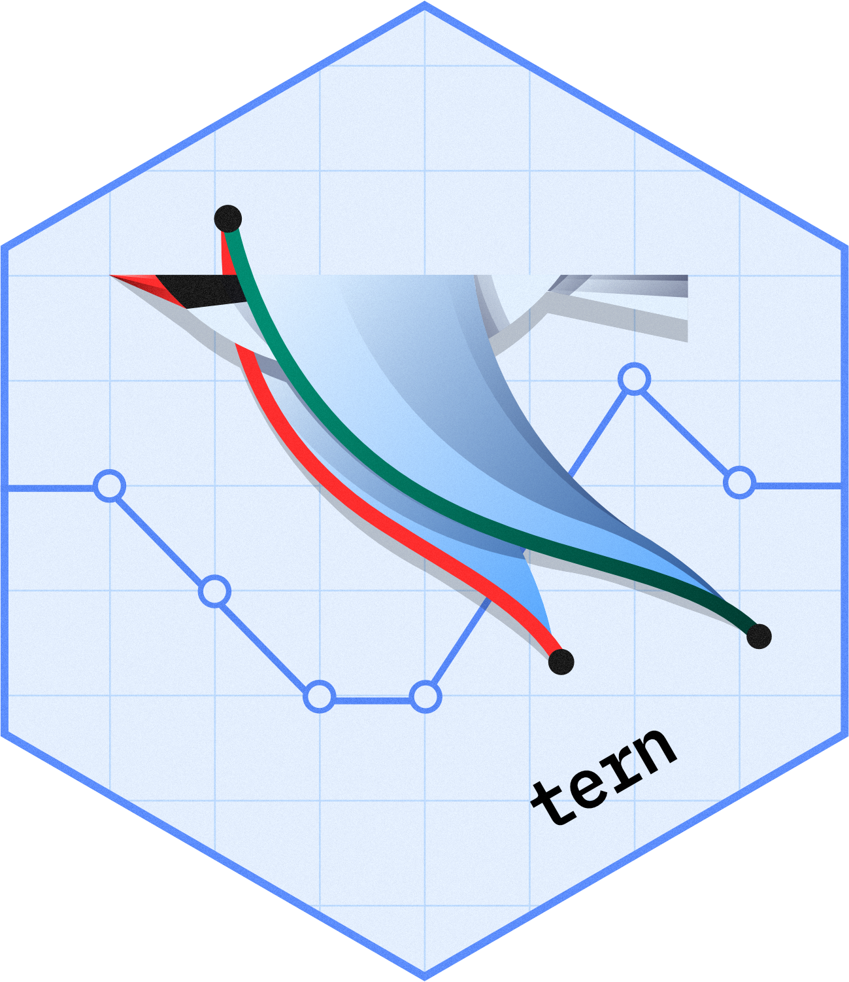


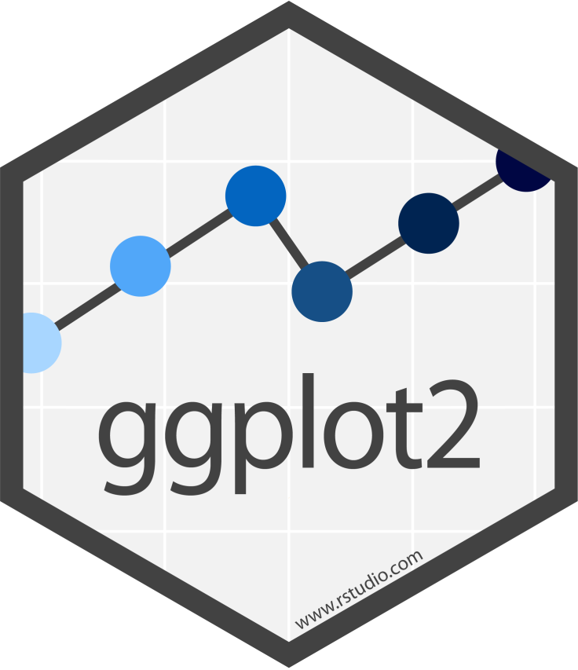
The NEST packages
NEST is a collection of open-sourced R packages, which enables fast and efficient insights generation under clinical research settings, for both exploratory and regulatory purposes.
Tables & Listings
TLG (Table Listing & Graphs) Toolkit
Standard Templates
Graphs
https://github.com/insightsengineering

Slide 5
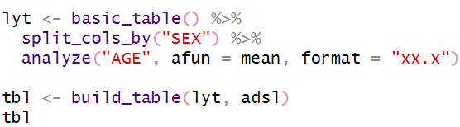
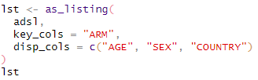
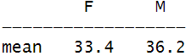
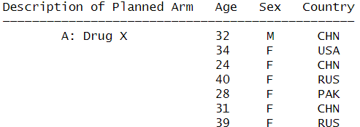
The NEST packages
Examples
{rtables}
{rlistings}

Slide 6
Challenges

Slide 7
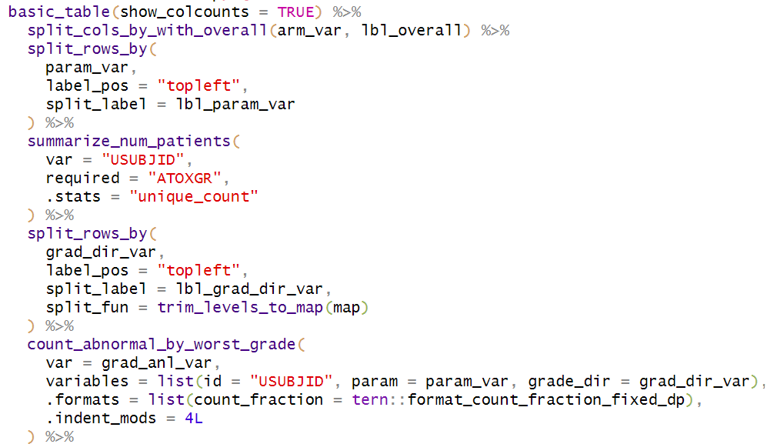
Creating TLG is (still) not easy
Creating a layout is time consuming.
Setting up parameters is difficult.
Data have to be processed to fit the code requirements.

Slide 8
Custom code is not always documented
Each step might be difficult to understand
Documentation might be missing in the script
It is difficult to know what to modify to customize the result.

Slide 9
Script validation is difficult
Subtitle goes here but is not mandatory
There is no guarantee that the result is correct.
The script might not handle edge cases well.

Slide 10
The {chevron} package

Slide 11
The {chevron} package
{chevron} is a collection of high-level functions to create standard outputs for clinical trials reporting with limited parameterisation.
pre
Corresponds
to one
Generates
main
post
Standard Template
Representing the structure of an expected table, listing or graph
chevron_tlg
An object with a preprocess, main and postprocess function
Table, listing or graph

Slide 12

The {chevron} package
Subtitle goes here but is not mandatory
User Friendly
Simple user interface
Informative log and error messages
Easy to control
Available on CRAN
Flexible & Scalable
Easy to customize
Can be extended
Robust
Daily validation
Extensive testing
Defensive programming
{chevron}
{rtables}
{tern}
{formatteres}

Slide 13
The run command
Create TLGs in one line
pre
adxx
run( , ) =>
main
post
chevron_tlg
An object with a preprocess, main and postprocess function
list of data.frames
Representing an ADaM data set.
Table, listing or graph

Slide 14
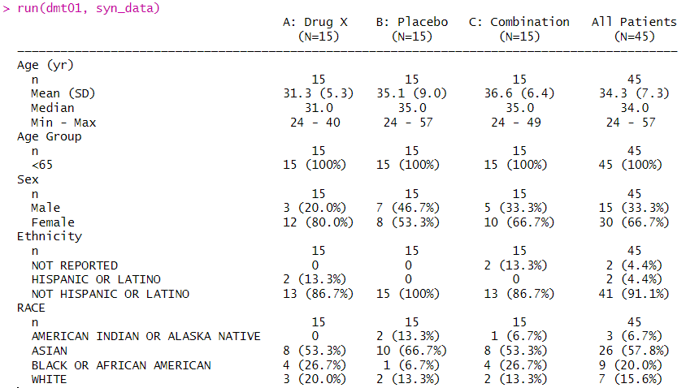
The run command
Create TLGs in one line: Example

Slide 15
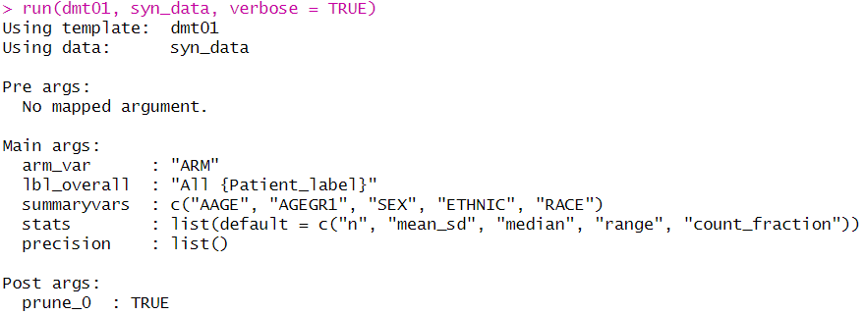
The run command
Generate log and create TLGs in one line: Example

Slide 16
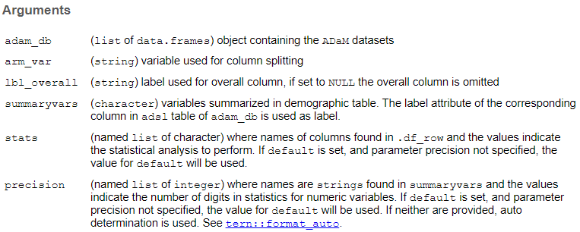
The controlling the run command
Customizing the output
pre
adxx
run( , ,arg1,...)
main
post

Slide 17
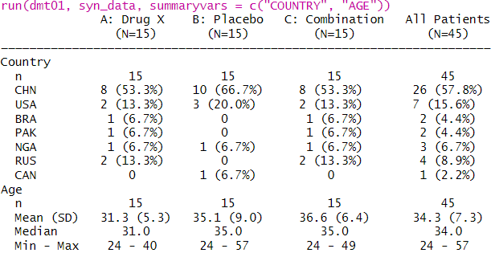
The controlling the run command
Customizing the output: Example

Slide 18
The chevron_tlg object
Internal structure
chevron_tlg
preprocessing
main
postprocessing
function(adam_db, …) {
adam_db <- wrangling(adam_db)
return(adam_db)
}
Expect: ADaM dataset
Return: processed dataset
E.g.: normalize data, create new columns, drop levels
function(adam_db, …) {
tlg <- build_tlg(adam_db)
return(tlg)
}
Expect: processed adam dataset
Return: TLG
E.g.: Create a demography table
function(tlg, …) {
tlg <- edit(tlg)
return(tlg)
}
Expect: TLG
Return: processed TLG
E.g. Remove rows with zero counts

Slide 19
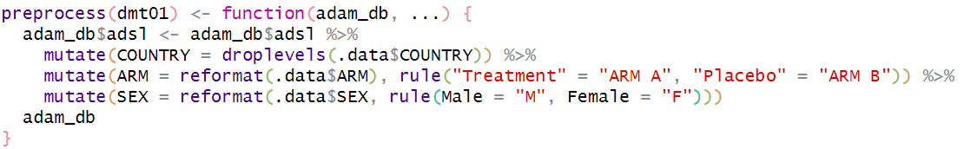
Extending {chevron}
Editing a chevron_tlg object
chevron_tlg
preprocessing
main
postprocessing
The new function must respect some (reasonable) conventions (see doc)
The other slots (main and postprocessing) can also be edited.

Slide 20
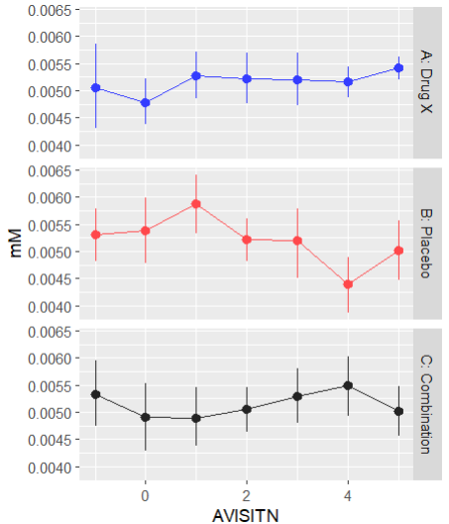
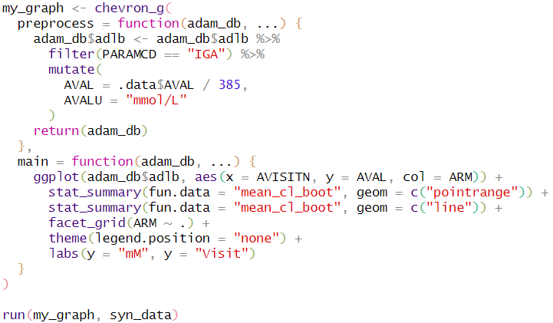
Extending {chevron}
Creating a new chevron object
Define some functions.
Embed them into a chevron object according to the desired output.
chevron_t (table), chevron_g (graph), chevron_l (listing)

Slide 21
Using {chevron} today
Where to start
Install {chevron} from CRAN
install.packages(“chevron”)
Access the documentation
https://insightsengineering.github.io/chevron/latest-tag/
Explore the available templates
https://insightsengineering.github.io/chevron/latest-tag/articles/chevron_catalog.html
Collaborate with us
https://github.com/insightsengineering/chevron

